Slide 1
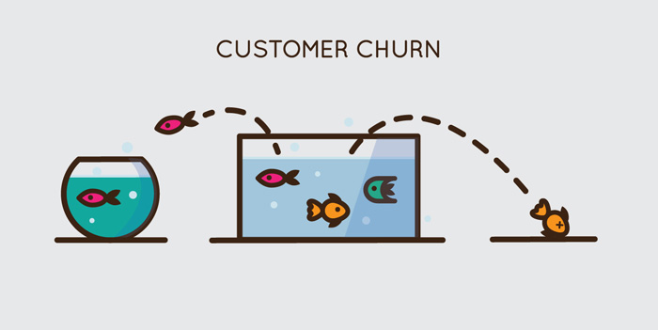
Telco Customer Churn
Tony John
Neeladri Mohapatra
Samarth Khare
Haw-Jan Hwang

Slide 2

What is Churn?
“The cost of acquiring a new customer can be higher than that of retaining a customer by as much as 700%. Increasing customer retention rates by a mere 5% could increase profits by 25% to 95%.”
Customer Churn Rate is the percentage of customers or subscribers who cancel or do not renew their subscriptions during a given period of time.

Slide 3
Business Problem Formulation
What attributes or variables can we employ so as to create a predictive model for customer churn in the telecom arena?
Which predictive models should we use to best predict the customer churn?
What are the different cost savings while employing various predictive models?

Slide 4
Data Description
CustomerID
Gender (female, male)
SeniorCitizen (Whether the customer is a senior citizen or not (1, 0))
Partner (Whether the customer has a partner or not (Yes, No))
Dependents (Whether the customer has dependents or not (Yes, No))
Tenure (Number of months the customer has stayed with the company)
PhoneService (Whether the customer has a phone service or not (Yes, No))
MultipleLines (Whether the customer has multiple lines r not (Yes, No, No phone service)
InternetService (Customer’s internet service provider (DSL, Fiber optic, No)
OnlineSecurity (Whether the customer has online security or not (Yes, No, No internet service)
OnlineBackup (Whether the customer has online backup or not (Yes, No, No internet service)
DeviceProtection (Whether the customer has device protection or not (Yes, No, No internet service)
TechSupport (Whether the customer has tech support or not (Yes, No, No internet service)
StreamingTV (Whether the customer has streaming TV or not (Yes, No, No internet service)
StreamingMovies (Whether the customer has streaming movies or not (Yes, No, No internet service)
Contract (The contract term of the customer (Month-to-month, One year, Two year)
PaperlessBilling (Whether the customer has paperless billing or not (Yes, No))
PaymentMethod (The customer’s payment method (Electronic check, Mailed check,
Bank transfer (automatic), Credit card (automatic)))
MonthlyCharges (The amount charged to the customer monthly — numeric)
TotalCharges (The total amount charged to the customer — numeric)
Churn ( Whether the customer churned or not (Yes or No))

Slide 5

Exploratory Data Analysis
We are trying to answer the following questions:
Are men more likely to churn than women?
Are senior citizens more like to churn?
Do individuals with a partner churn more than those without a partner?
Do people with dependents churn more than people that do not have dependents?

Slide 6
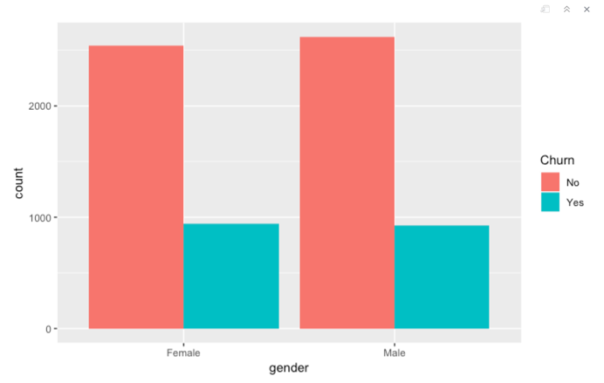
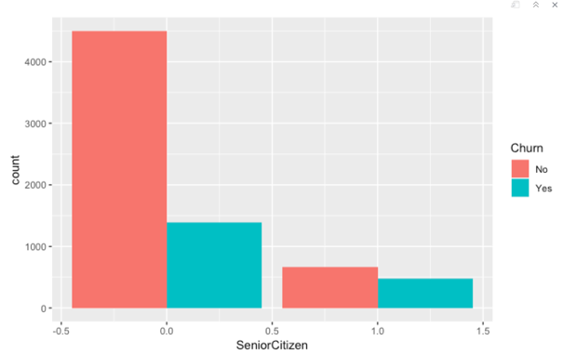
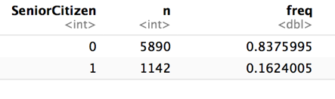
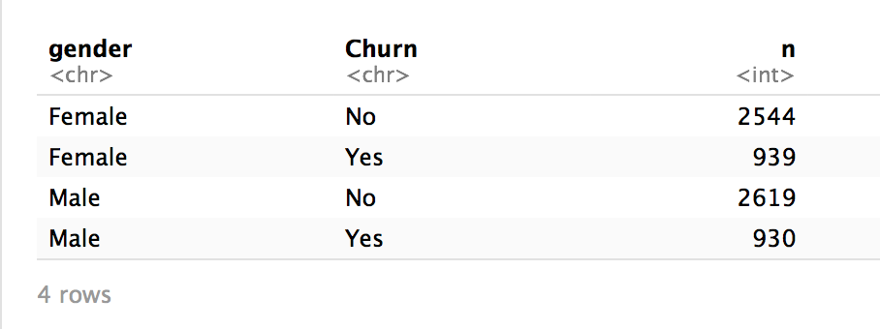
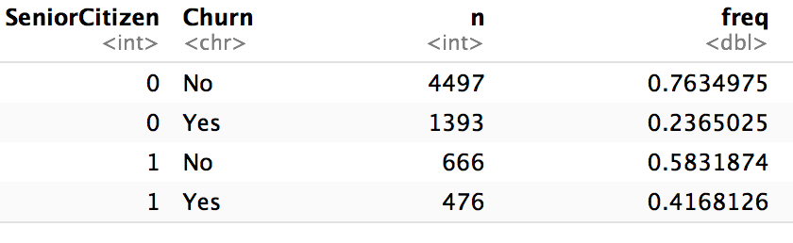
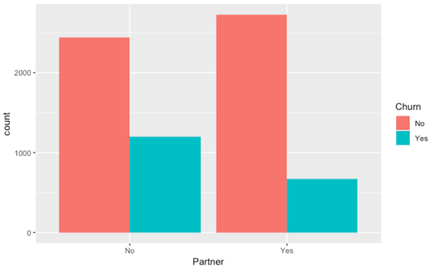
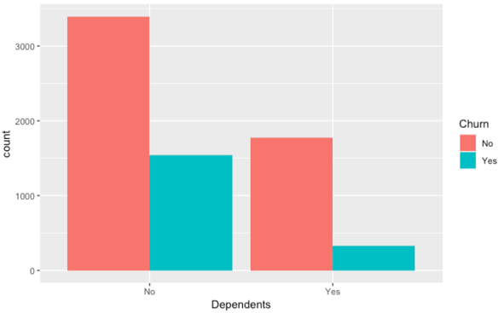
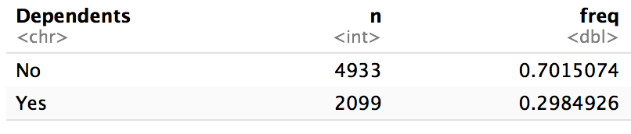
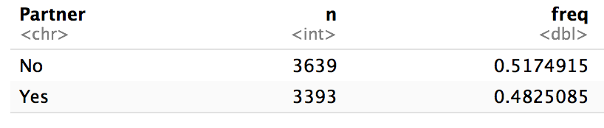
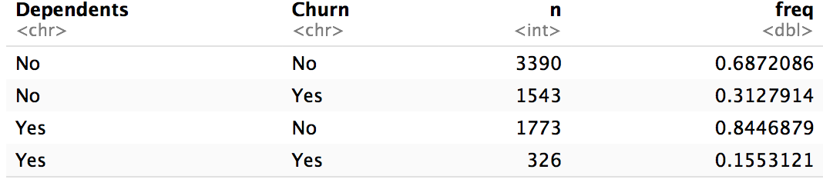
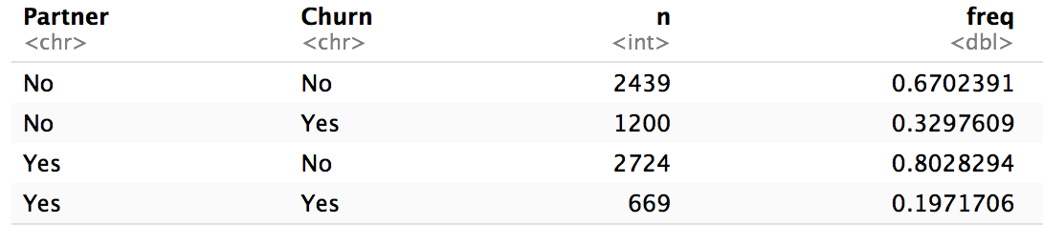
Exploratory Data Analysis-1
Senior Citizens
Gender
Dependents
People w/ Partners

Slide 7
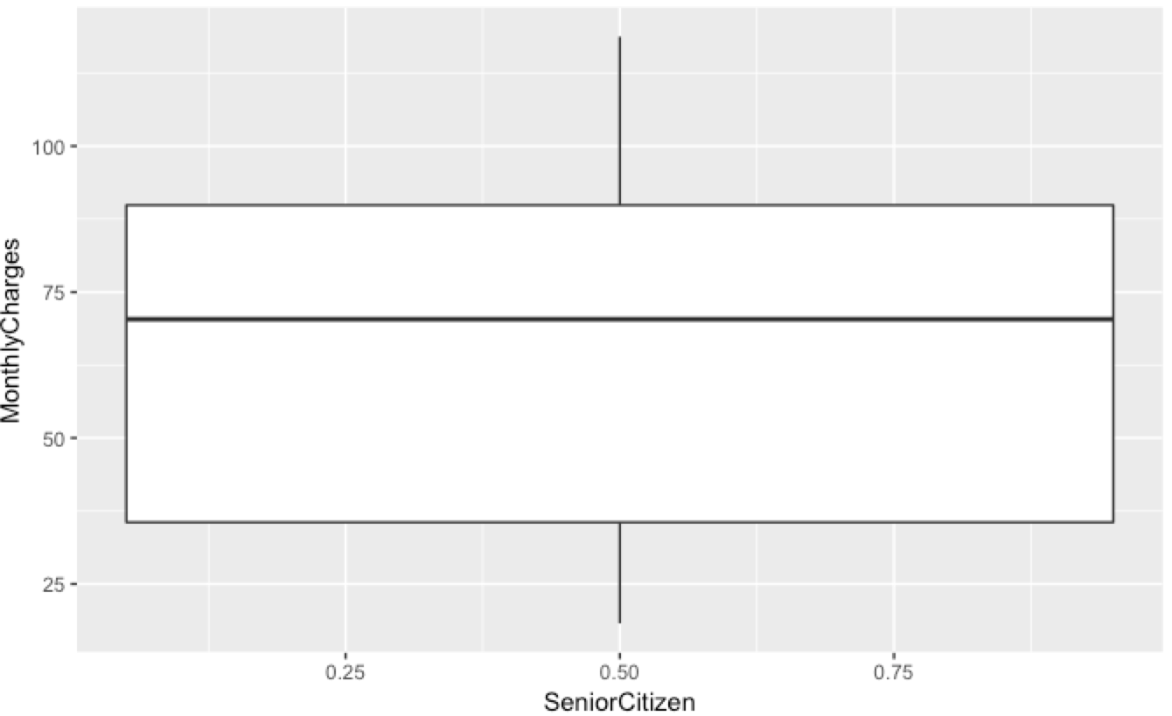
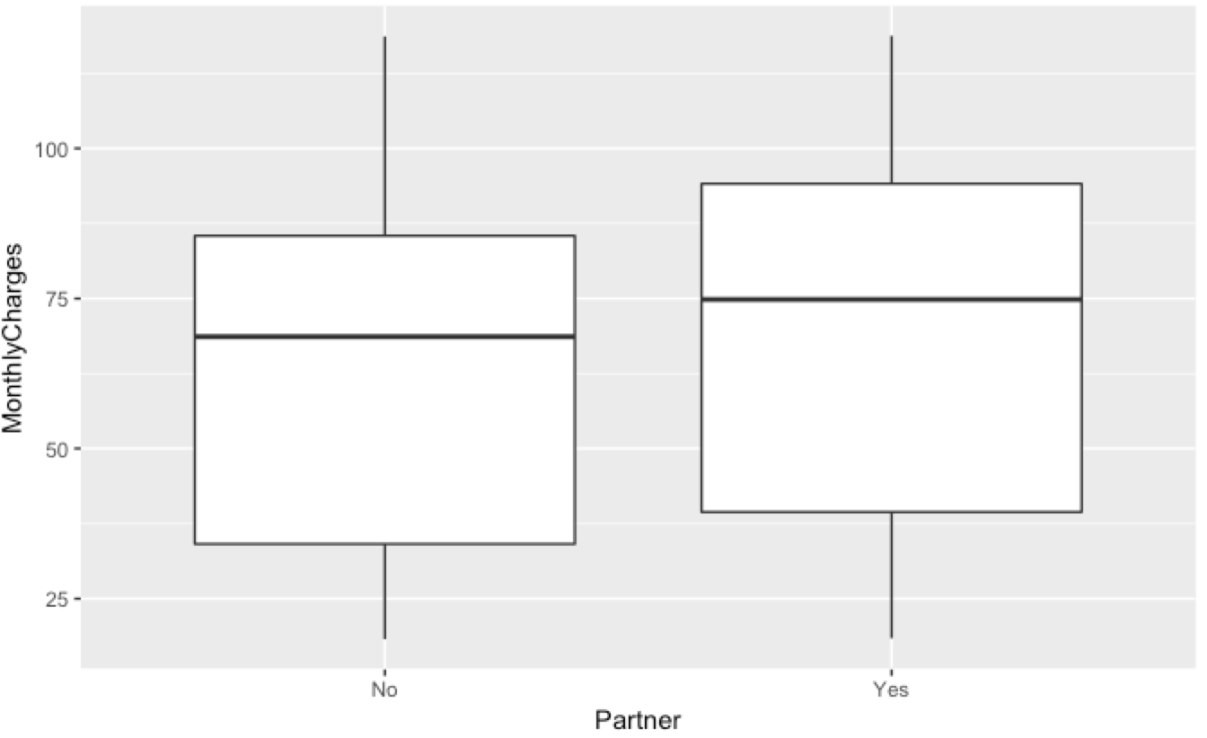
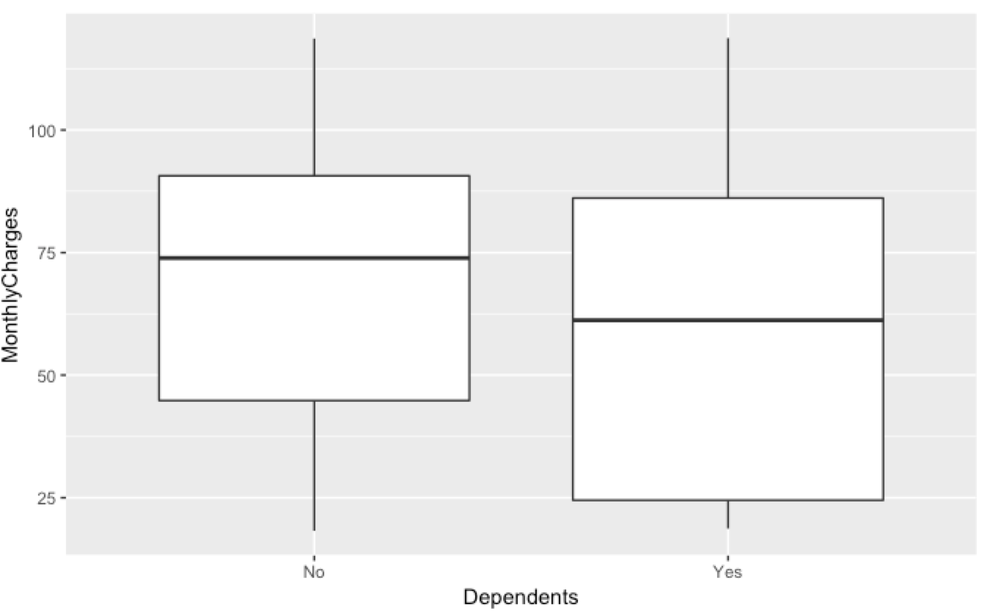
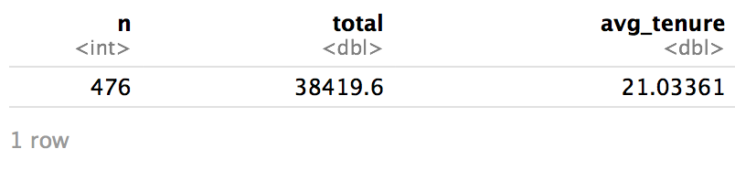
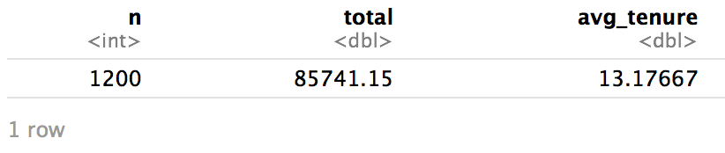
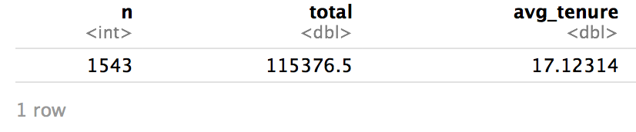
Exploratory Data Analysis-2
Another useful visualization is the box and whisker plot. This gives us a little bit more compact visual of our data, and helps us identify outliers. We also take a look at some box and whisker plots for total charges of the different customer segments.
After looking at these initial results, we must compare the total charges of senior citizens, people without partners, and people without dependents.

Slide 8
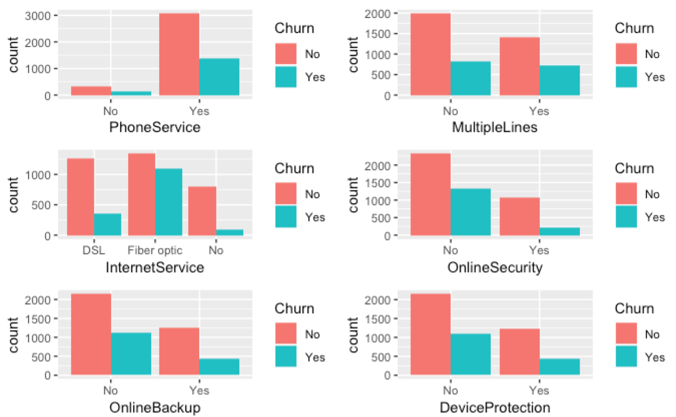
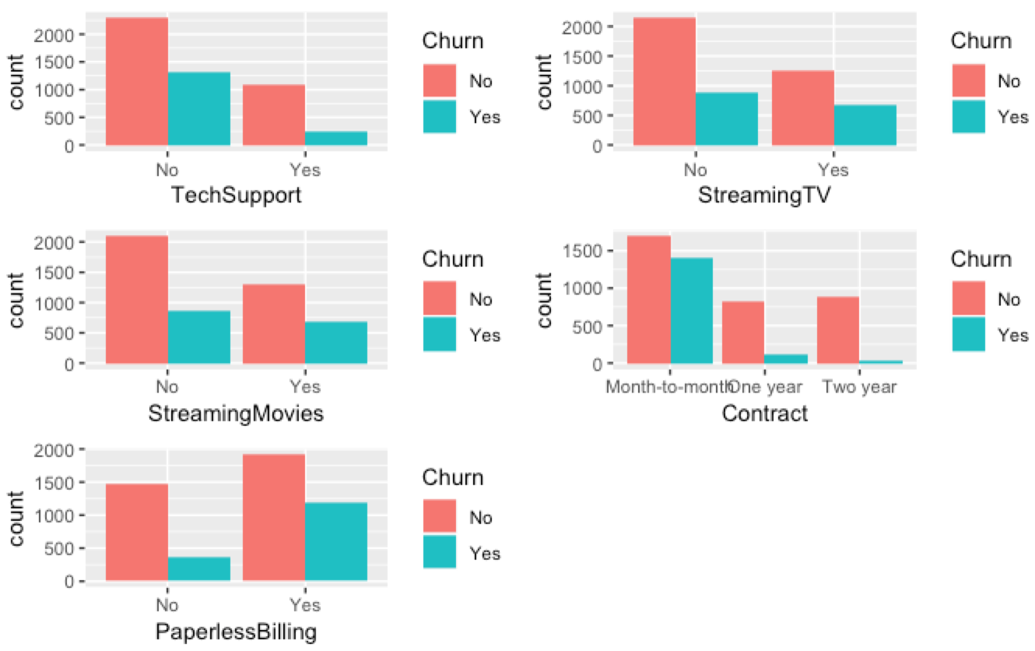
We go even further and find what services the customer segment with no dependent uses using the following grid points.
Exploratory Data Analysis-3

Slide 9
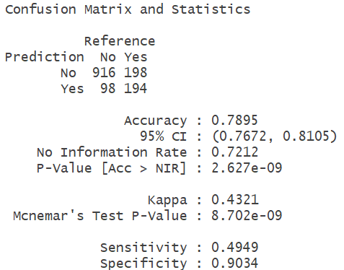
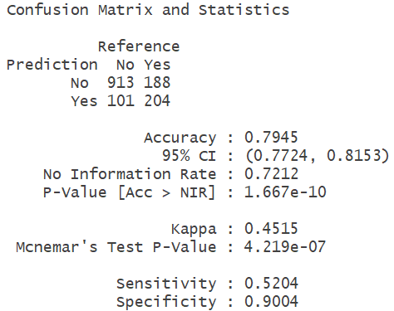
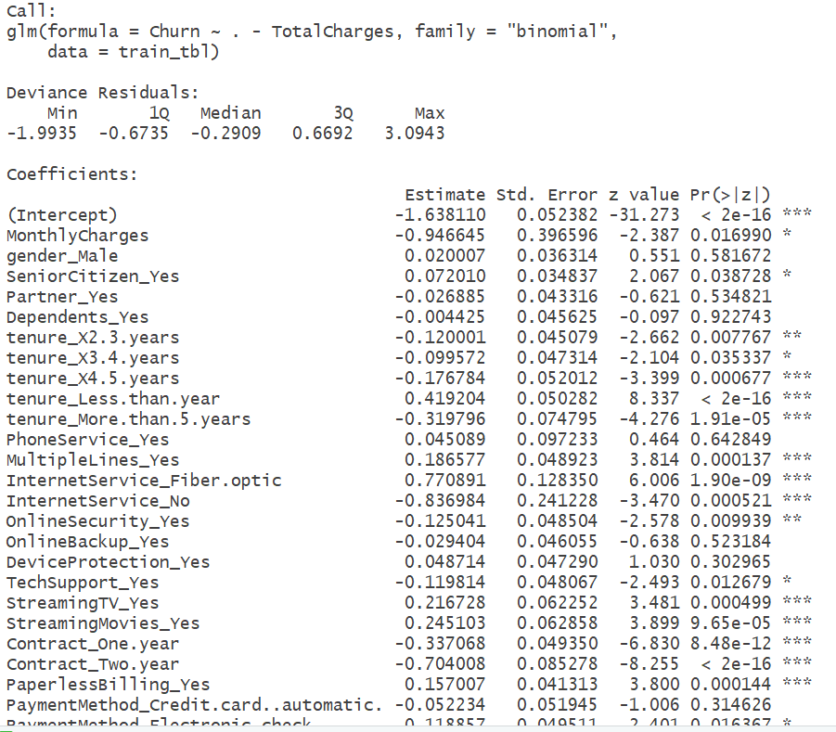
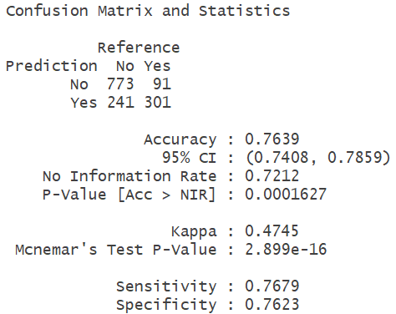
Parametric Models – Logistic Regression, LDA, QDA
Logistic regression model summary
LDA
LDA model accuracy – 79.45%.
Improved accuracy but less interpretability.
QDA
QDA model accuracy – 76.39%.
Degraded accuracy but better sensitivity (76.79%).
Logistic regression model accuracy - 78.95%.
The model has better interpretability and evaluating predictor significance.
Observations
Further improvement possible through feature selection.
TotalCharges removed from model due to high collinearity with MonthlyCharges and Tenure variables.

Slide 10


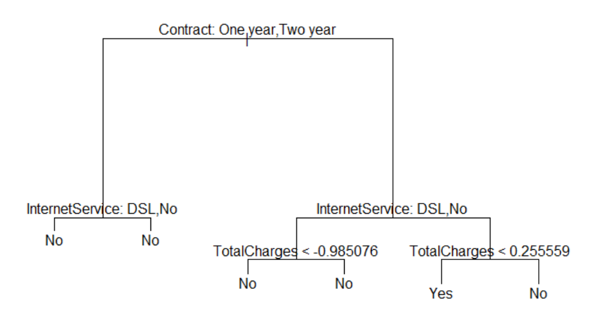

Non Parametric Models – Decision Tree, KNN
Decision tree model
Prune Decision tree model
KNN (K=100)
Decision tree model accuracy – 77.45%.
KNN model accuracy – 79.52%.
Further tuning of K possible to improve accuracy.
* Sample tree
Decision tree pruned by limiting the number of terminal nodes to 5
Improved model accuracy – 77.52%.
Observations
Faster modeling, no data normalization required for decision tree method but prone to overfitting.
Further improvement of decision tree possible though ensemble methods like boosting.

Slide 11
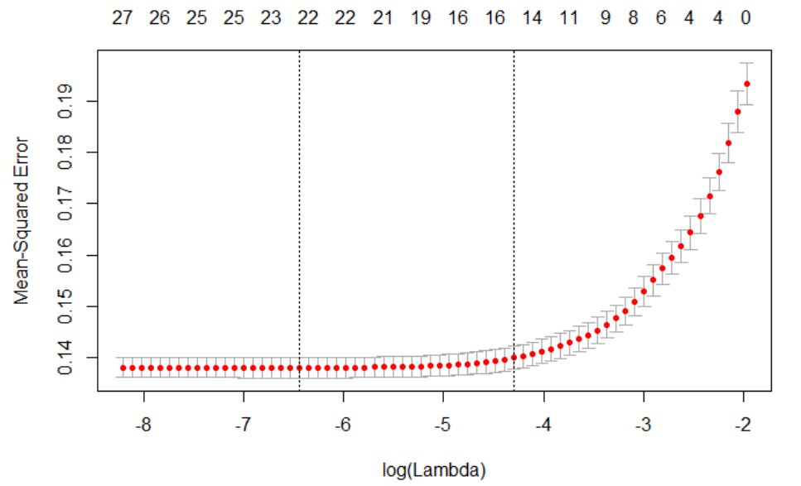
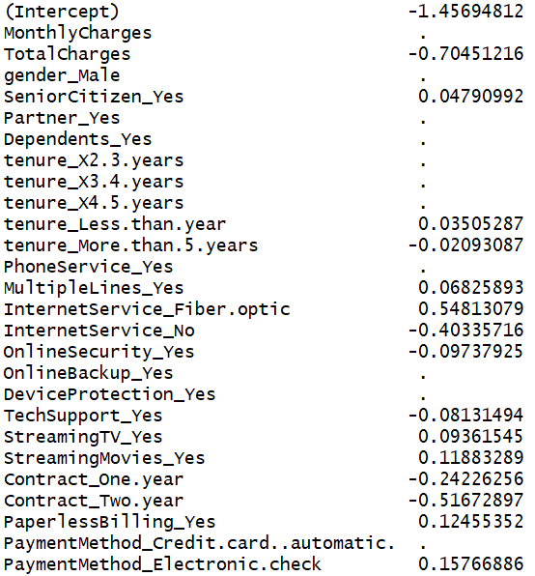
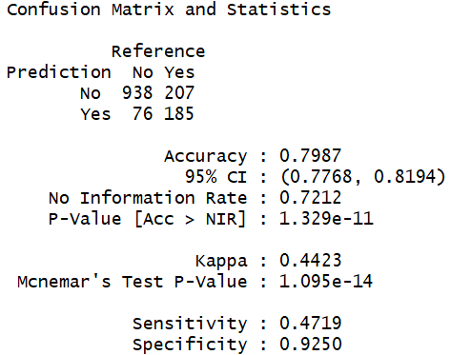
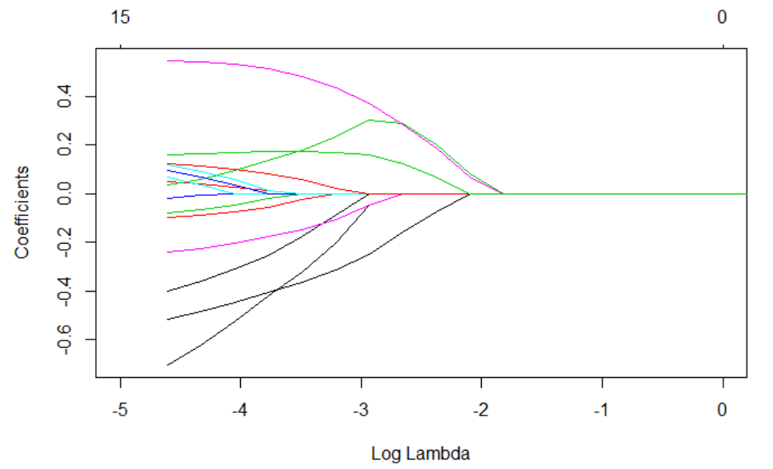
Improvement Models – Shrinkage method (LASSO)
Binomial Lasso model
Coefficients of non-significant predictors are reduced to zero.
Decrease in variables reduces overfitting, thereby decreasing variance while testing with unknown data.
Model accuracy improved to 79.87% but with reduced sensitivity on testing.

Slide 12
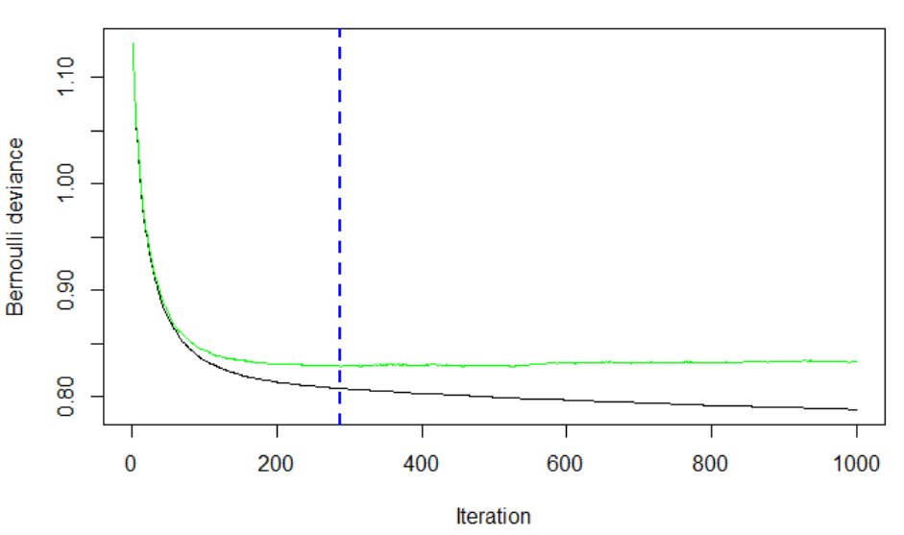
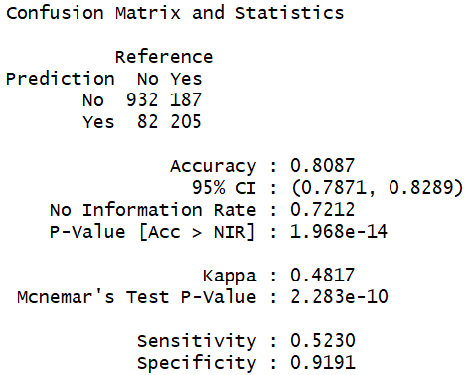
Improvement Models – Ensemble method(Boosting)
Gradient boosted model
Hyperparameters Used
interaction.depth=1 (Maximum depth of each tree)
bag.fraction = 0.4 (fraction of training test used to propose for next tree)
cv.folds=10 (10- fold cross validation)
n.trees =1000 (Total #trees to fit)
shrinkage = 0.1 (learning rate)
Best in class accuracy of 80.87%
Hyperparameter tuning required to improve the model accuracy.
Early stopping using 10 fold cross-validation performed to eliminate overfitting problem with GBM models.

Slide 13
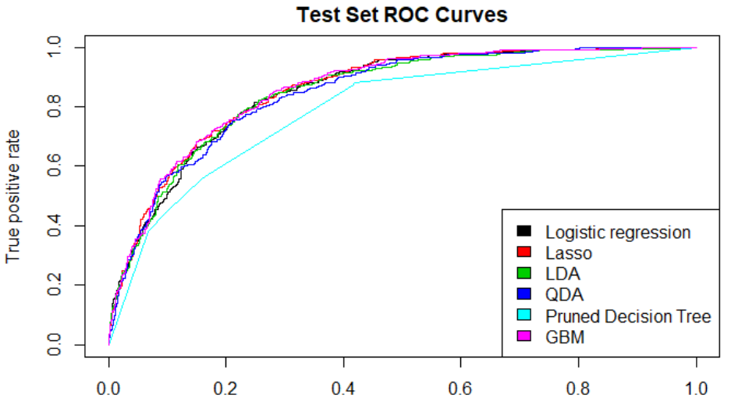
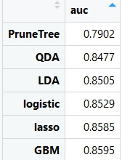
Model Evaluation – ROC and AUC
Taking AUC as measure of model evaluation – higher the better.
GBM having highest area under the ROC curve – 0.8595

Slide 14
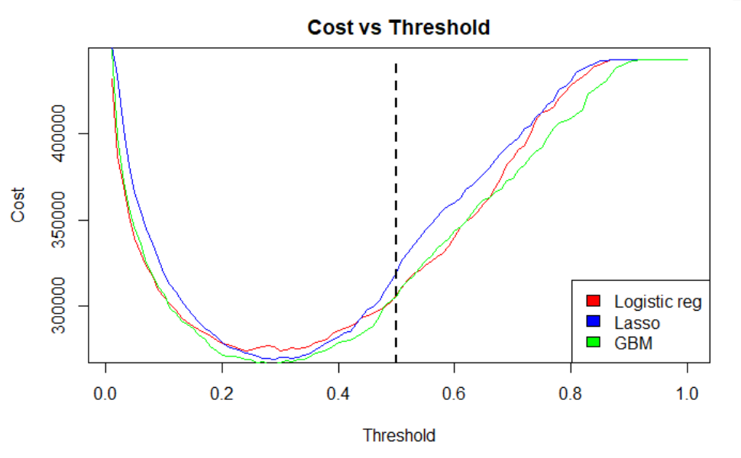

Cost Considerations
Assumptions
1. The cost of a customer churn = $300
2. The cost of offers offered to churnable customer = $80
3. All customers offered a offer was retained.
Better cost savings by fixing a threshold near 0.30 than 0.5 while taking into account cost of TP and FP/FN predictions.
Cost savings of 87.31% ($470960) using a prediction model on test dataset (~1400 user).

Slide 15
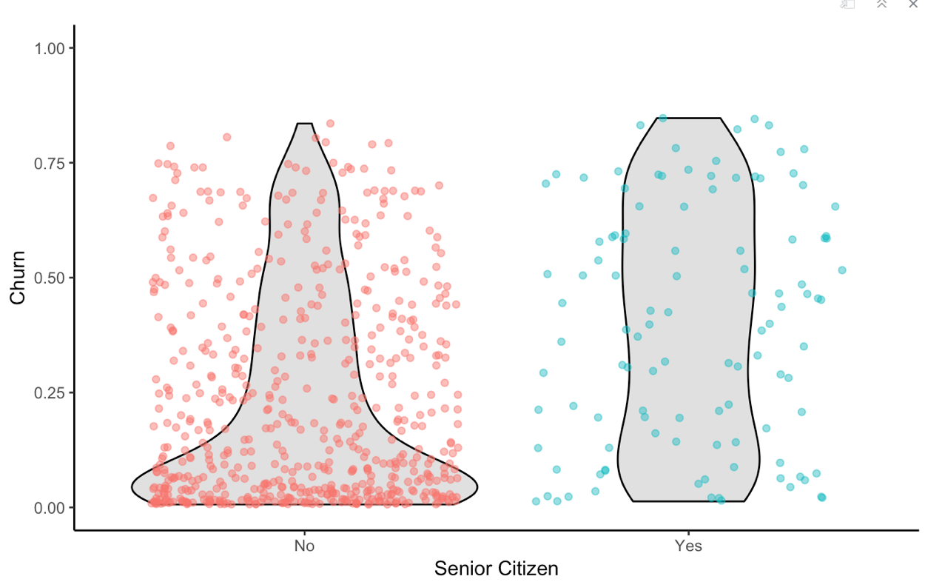
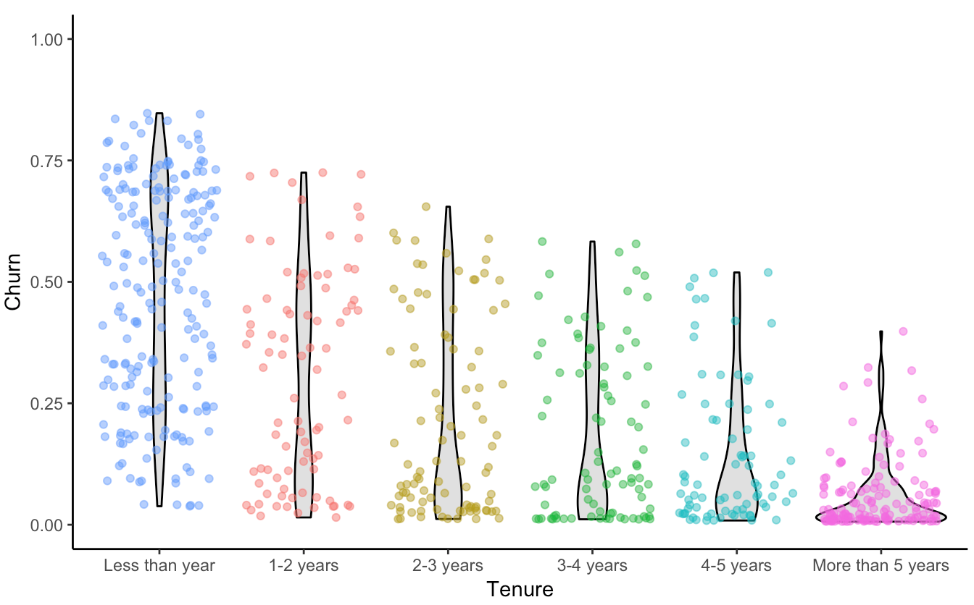
Inferences
Inference: Senior citizen appeared in several of the cases indicating it was important to the model for all samples. However, it was not highly correlated to Churn, which may indicate that the model is using in an more sophisticated manner (e.g. as an interaction). It’s difficult to say that senior citizens are more likely to leave, but non-senior citizens appear less at risk of churning.
Opportunity: Target users in the lower age demographic.
Senior Citizen
Tenure
Inference: There is an indication that the predictive model is using this feature frequently and high correlation agrees that this is important. Investigating the feature distribution, it appears that customers with lower tenure (bin 1) are more likely to leave.
Opportunity: Target customers with less than 12 month tenure.

Slide 16
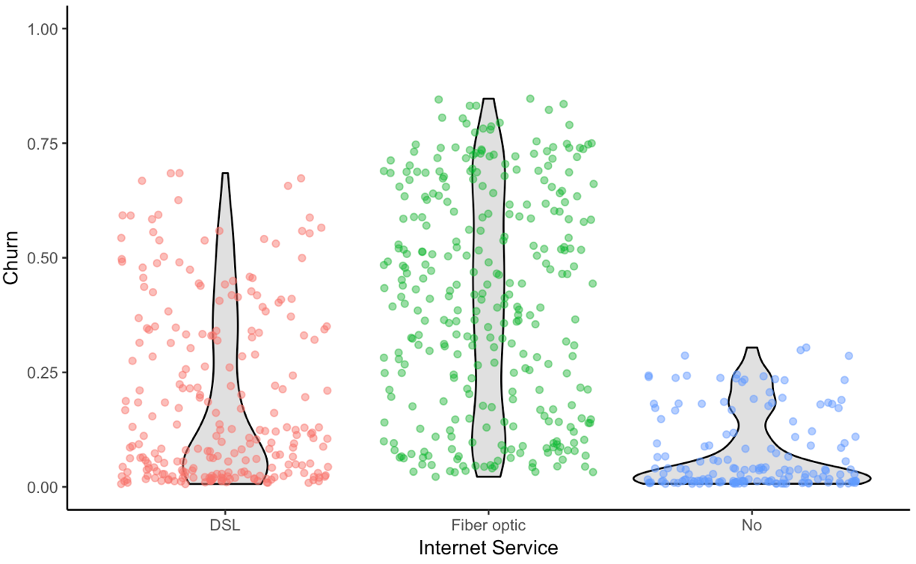
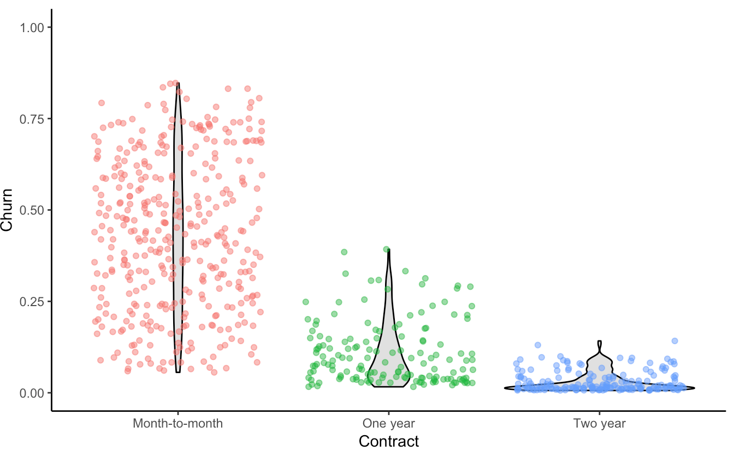
Inferences
Internet Service
Inference: While the predictive models did not indicate this as a primary feature in the sample cases, the feature is clearly correlated with those electing to stay. Customers with fibre optic service are more likely to churn while those with no internet service are less likely to churn.
Area of Improvement: Customers may be dissatisfied with fibre optic service.
Contract
Inference: While the predictive models did not indicate this as a primary feature in the sample cases, the feature is clearly correlated with those electing to stay. Customers with one and two year contracts are much less likely to churn.
Opportunity: Offer promotion to switch to long term contracts.

Slide 17
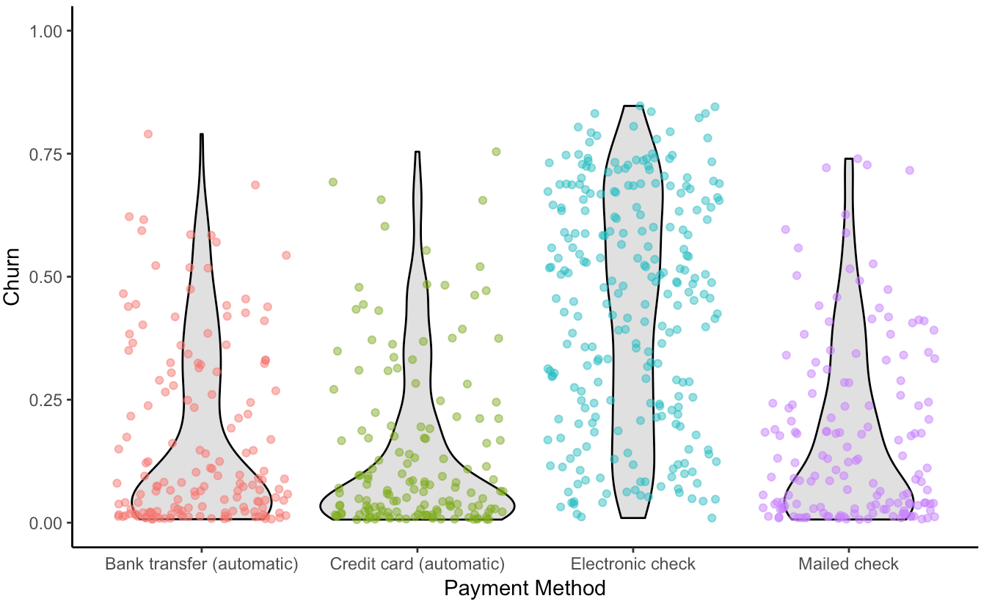
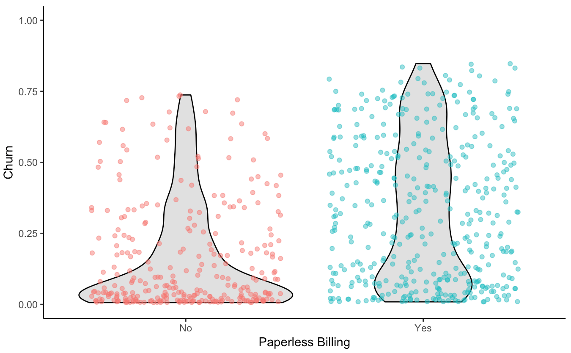
Inferences
Inference: While the predictive model did not indicate this as a primary feature in the sample cases, the feature is clearly correlated with those electing to stay. Customers with electronic check are more likely to leave.
Opportunity: Offer customers a promotion to switch to automatic payments.
Payment Method
Paperless Billing
Inference: Paperless Billing appeared in several of the cases indicating it was important to the model for all samples. However, it was not highly correlated to Churn. So it’s tough to tell whether customers preferring Paperless Billing are more likely to leave, but customers not preferring Paperless Billing appear less at risk of churning.
Opportunity: This criteria may not provide much opportunity for the company.

Slide 18
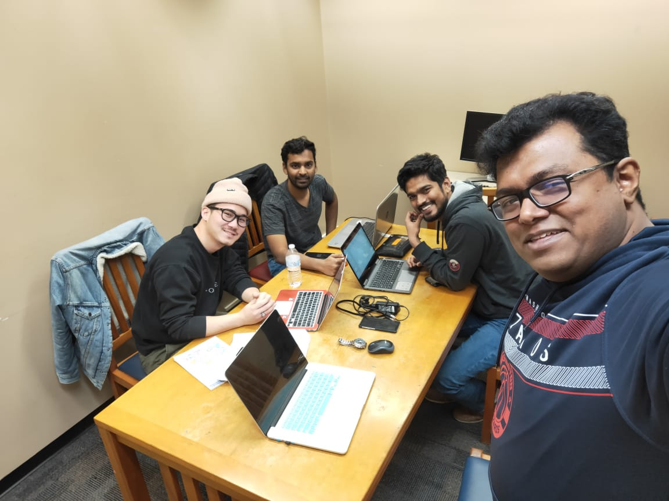
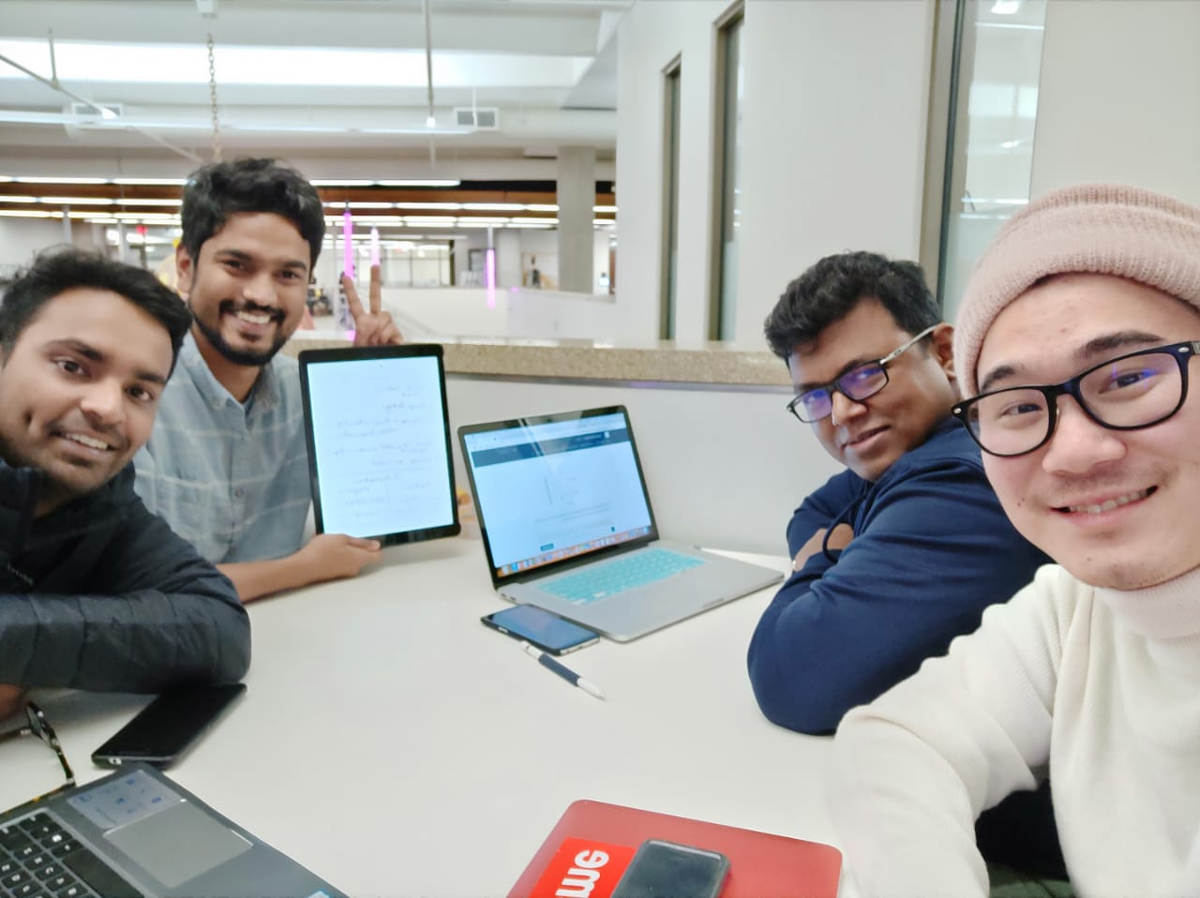
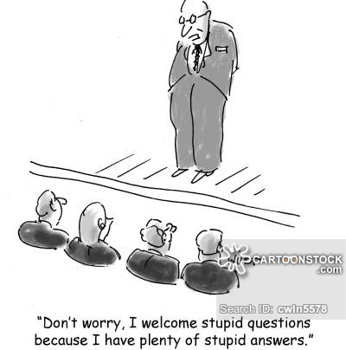
Q & A Time!!!!

